Slide 1
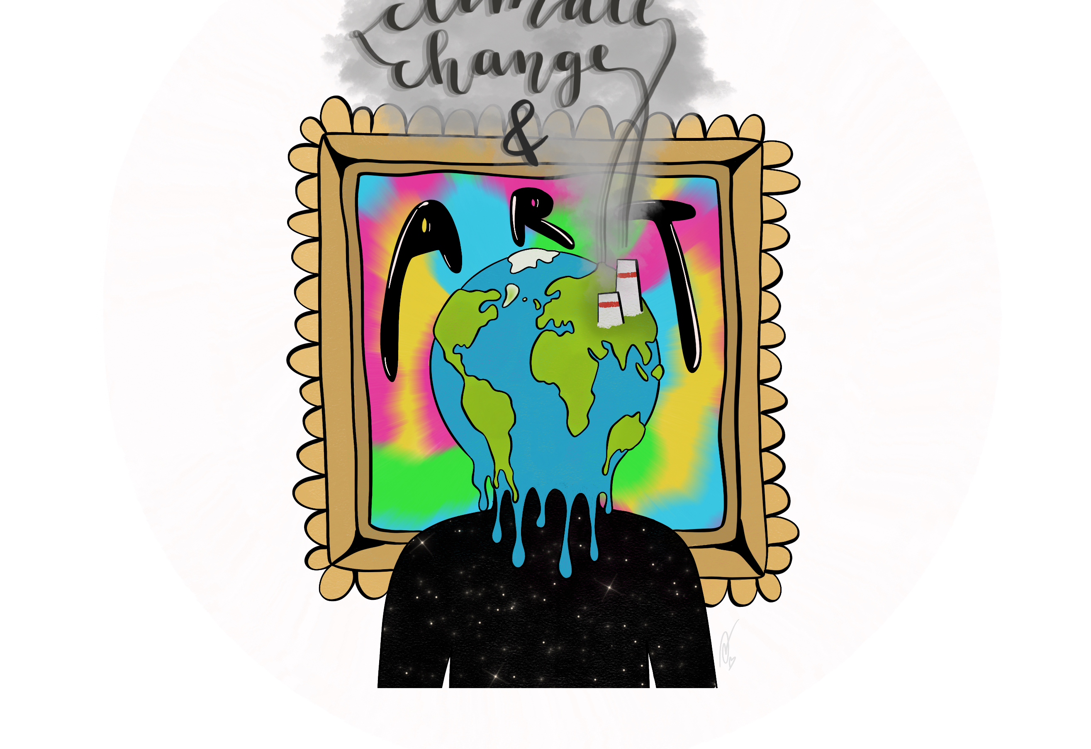
How does climate change challenge marine life in Poland?

Slide 2
What will you learn from this presentation?
What is global warming and what is causing it?
The concept of megatrend
How will climate change affect the marine environment in Poland?

Slide 3
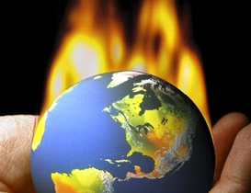
What is the warming mechanism?
To zdjęcie wykonane przez nieznanego autora jest objęte licencją CC BY.

Slide 4
The most important greenhouse gases
Steam
Gaseous state of water
Acts as a climate regulator
Carbon dioxide
An inorganic chemical compound from the group of oxides
Non-flammable gas, heavier than air
Methane
Organic chemical compound, the main component of natural gas
Its huge amount releassed into the air causes an immediate warming effect

Slide 5
Increasing gas concentration
Hindered return of energy into space
The temperature of the Earth is rising

Slide 6
The importance of the megatrend

Slide 7
What is a megatrend?
We can describe a megatrend as complex phenomena on a macro scale, driving changes of a wide, global and supra-regional scope, occurring in various spheres – both social, economic, political, enviromental and technological

Slide 8
We divide megatrends into:
Human life and activity
Mechanisms
Planet limitations

Slide 9
Poland in the face of the megatrend
Threats
Consequences of threats
Intensifying extreme weather phenomena
Increasing flood risk
Severe droughts (lowering of the groundwater level)
Increased risk of forest fires
Damage to infrasructure
Agricultural burden
Extension of the vegetation period of plants
The growing importance of invasive species
The occurrence of shutdowns in power plants during summer periods
Hurricanes
Whirlwinds
Heat waves
Violent storms

Slide 10
How will climate change affect the marine environment in Poland?
To zdjęcie wykonane przez nieznanego autora jest objęte licencją CC BY-NC-ND.

Slide 11
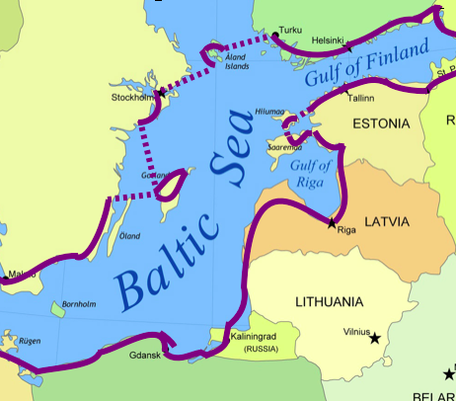
A few words about the sea, which is the northern border of Poland
To zdjęcie wykonane przez nieznanego autora jest objęte licencją CC BY.

Slide 12
The Baltic Sea is a relatively small (415 266 km²) and cold body of water (around 12*C), which is a sea border for 8 countries. Due to its poor salinity, fauna and flora are not numerous (only 85 naturally occurring plant species and 52 animal species), which makes the Baltic Sea one of the least inhabited seas. Due to the low salt level, some parts of the Baltic Sea are inhabited by freshwater fish, which diversify the fauna of our sea.
To zdjęcie wykonane przez nieznanego autora jest objęte licencją CC BY-SA-NC.

Slide 13
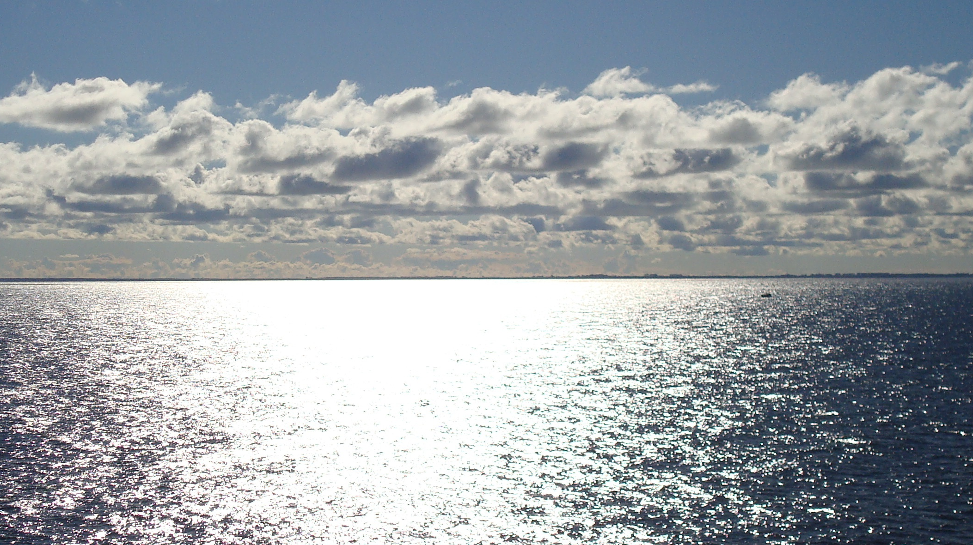
What will happen to the Baltic Sea...?
To zdjęcie wykonane przez nieznanego autora jest objęte licencją CC BY-SA.

Slide 14
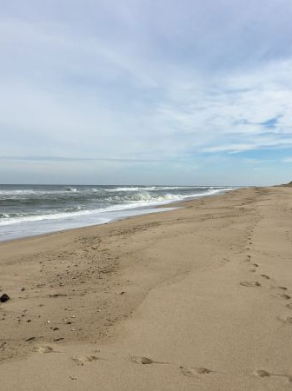
Due to its temperature, the Baltic Sea is very vulnerable to climate change. Plants and animals that live in chilly water can't tolerate the relatively sudden rise in temperature. Due to its location in the Baltic Sea, there is a large climatic variation in specific seasons. Climate change can extend the growing season, which may disturb plant development, and cause hunger and air pollution.

Slide 15
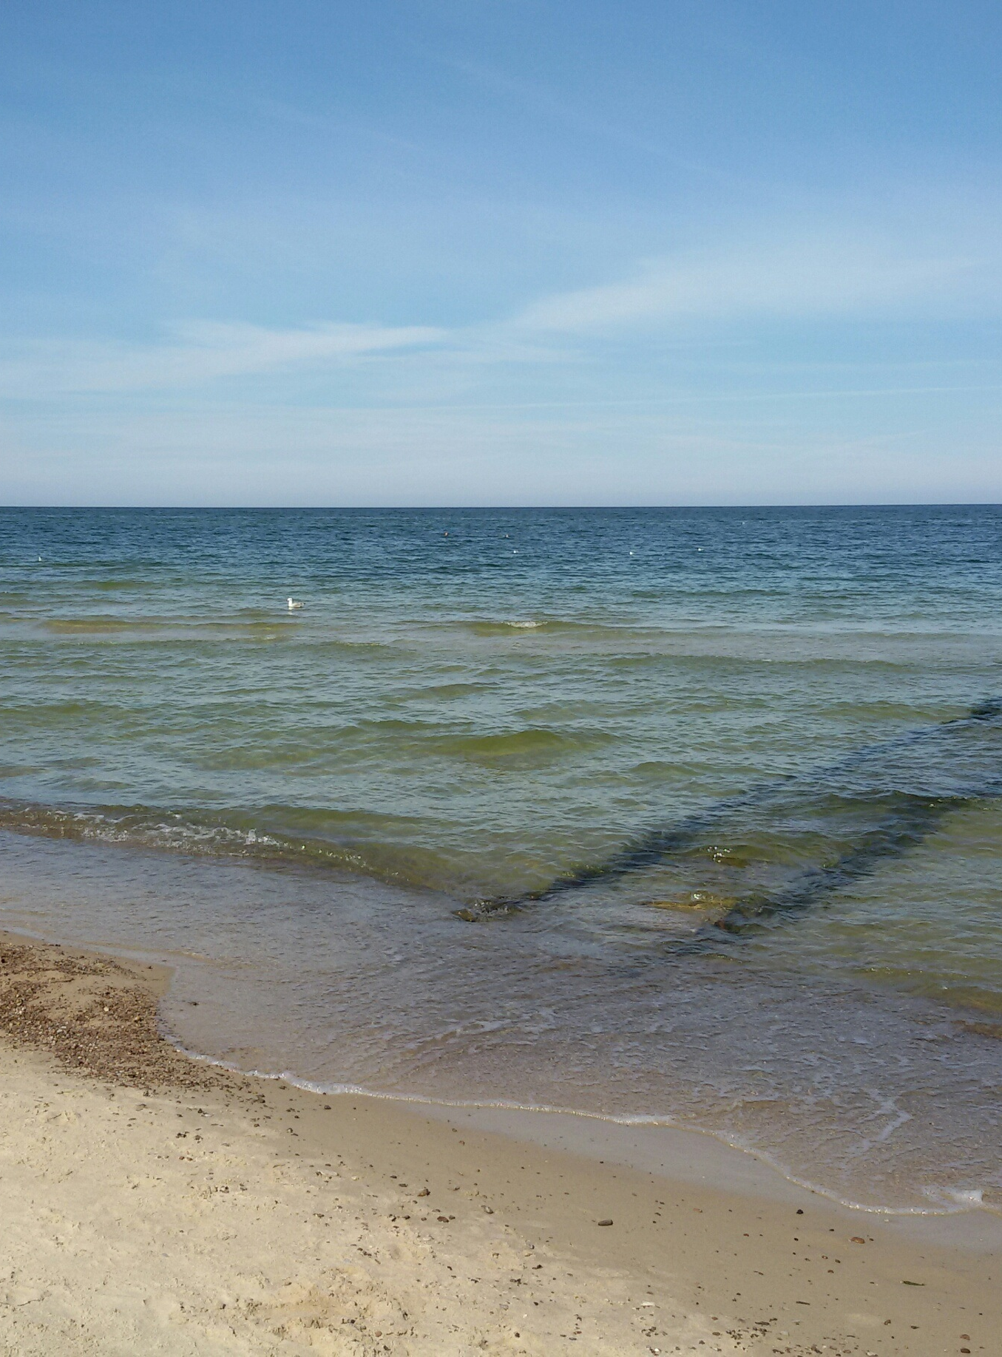
The projected climate change is likely to reduce the salinity of the Baltic Sea. It will be the largest in the area of ​​the Danish Straits, and the smallest in the northern and eastern Baltic Sea. The forecast changes will be uniform throughout the year. The predicted changes in the salinity of sea waters result from the predicted changes in the river runoff. It is forecast to increase from a few to a dozen or so percent in the entire catchment area.

Slide 16
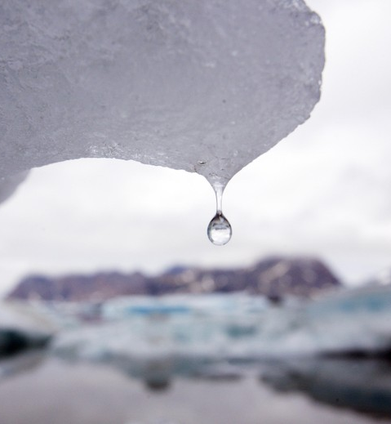
Climate change also causes milder winters, with the result that ice sheet reduction, natural protection against storm surges, is to be expected, and the shore's resistance to blurring is reduced.
To zdjęcie wykonane przez nieznanego autora jest objęte licencją CC BY.

Slide 17
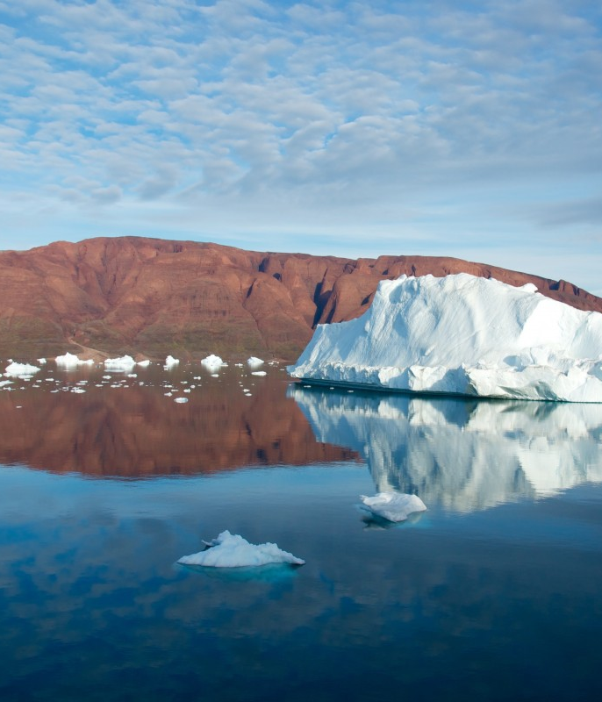
Mathematical models show that, in general, almost the entire catchment area of ​​the sea is experiencing a renewed climate change and a shortening of its duration. This is only a general trend, which does not exclude the occurrence of years with extreme conditions. Thanks to this, we will collect a huge amount of data of protecting snowy climates. In the south snow ice sheet can melt by as much as 75%.

Slide 18
The effects of climate change...
One of the best known effects of climate change is the rise in sea and ocean levels due to melting ice sheets. Forecasts of the size of the Baltic Sea level rise in the 21st century vary greatly, depending on the modeling approach, level of confidence and uncertainty. The values ​​given by specialists vary between 0.6 and 1.1 m. It is worth noting here that the rise in sea level is partially compensated by isostatic movements of the earth's crust.

Slide 19
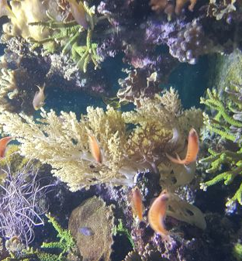
Impact of changes on biodiversity ...
One of the basic factors having a direct impact on the functioning of organisms is temperature. Temperature increase may affect the species structure of organisms inhabiting the Baltic Sea. Climate change may be favoring the displacement of cold-water organisms by warm-water species.
The impact of humans on the Baltic Sea in many cases may exacerbate the adverse impact of changing climatic conditions. This, of course, applies to the aforementioned supply of nutrients. However, it is also worth paying attention to overfishing. In this way, man contributes to the reduction of biodiversity.

Slide 20
Summary
what will happen in the future...

Slide 21
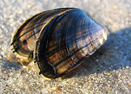
The models showed that before 2100 the salinity of the Baltic Sea would drop and its temperature would rise as a consequence of rising air temperatures and rainfall. Warmer air will reduce the oxygen content in water, and thus progressive eutrophication. Changes in salinity, in turn, will see species on the verge of extinction disappear, leading to a decline in biodiversity. One example is the blue mussel, which cannot survive in an environment with less salinity than there currently exists in the northern part of the Baltic Sea.
To zdjęcie wykonane przez nieznanego autora jest objęte licencją CC BY-SA.

Slide 22
Thank you for your attention
Presentation made by:
Aleksandra Kłos, Konrad Chmielewski

Slide 23
Bibliography
https://klimada2.ios.gov.pl/baltyk-a-zmiany-klimatu/
https://www.clientearth.org
https://climateknowledgeportal.worldbank.org
https://www.wwf.pl/aktualnosci/zmiana-klimatu-srodowisko-morskie-i-rybolowstwo
https://www.eea.europa.eu/pl/sygna142y/sygnaly-2015/artykuly/zmiany-klimatu-a-morza
own knowledge
all photos are licensed under Creative Commons

