Slide 1
Spring Weekend Haiku

Slide 4
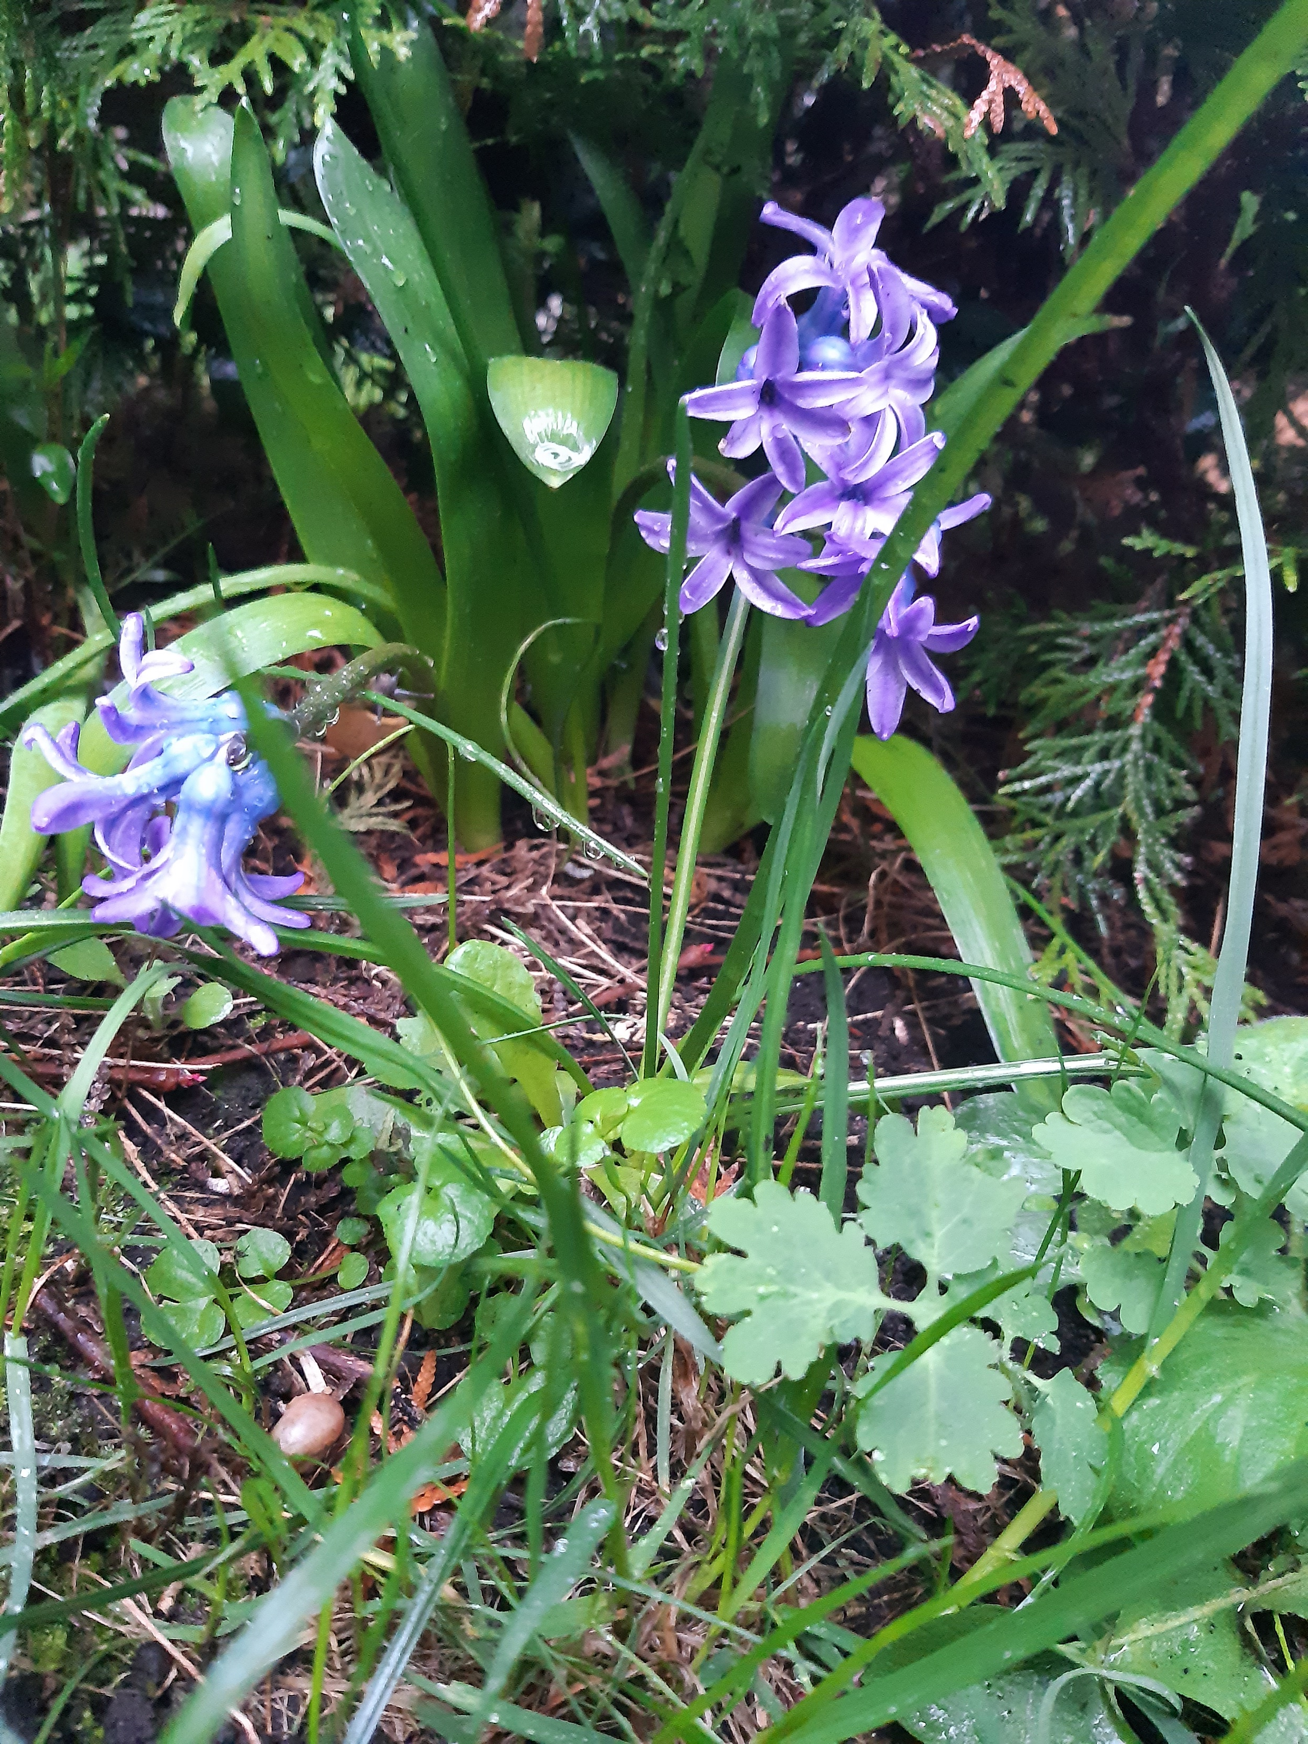
spring breeze woke me up
put fresh flowers on my cheeks
I missed this feeling

Slide 6
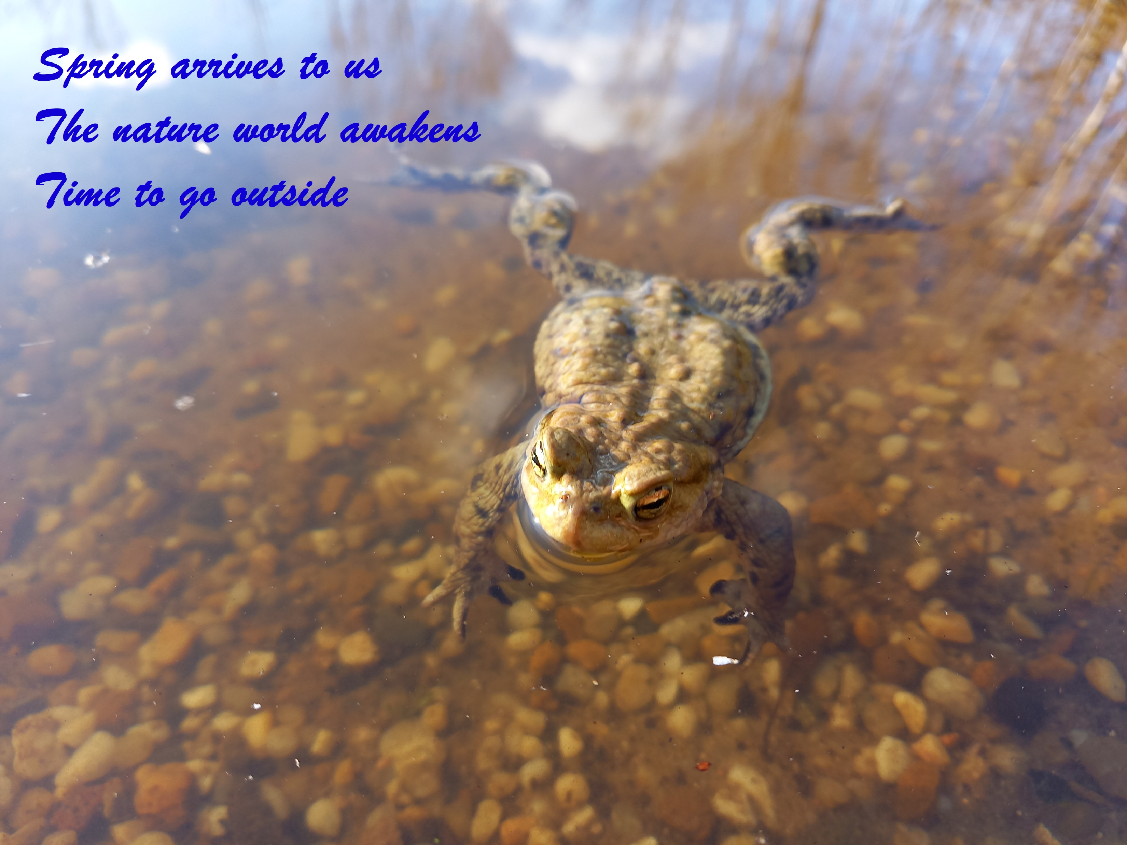

Slide 10
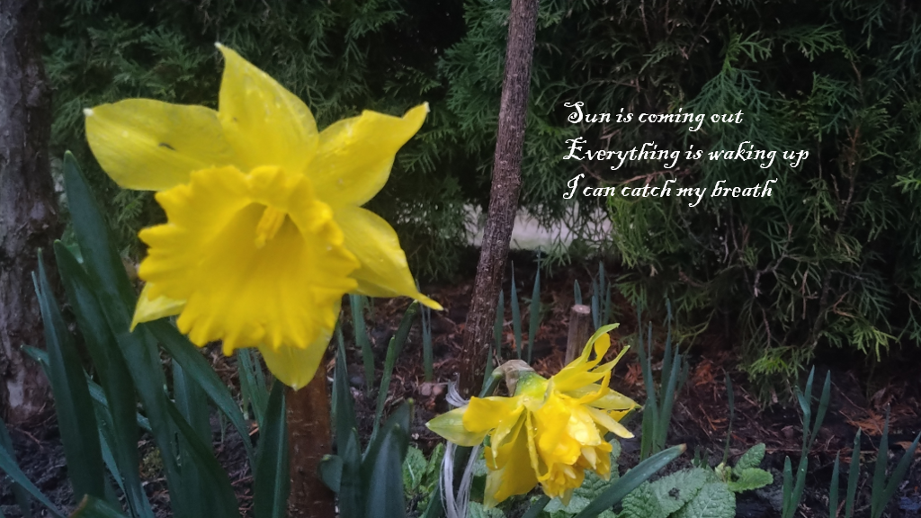

Slide 11
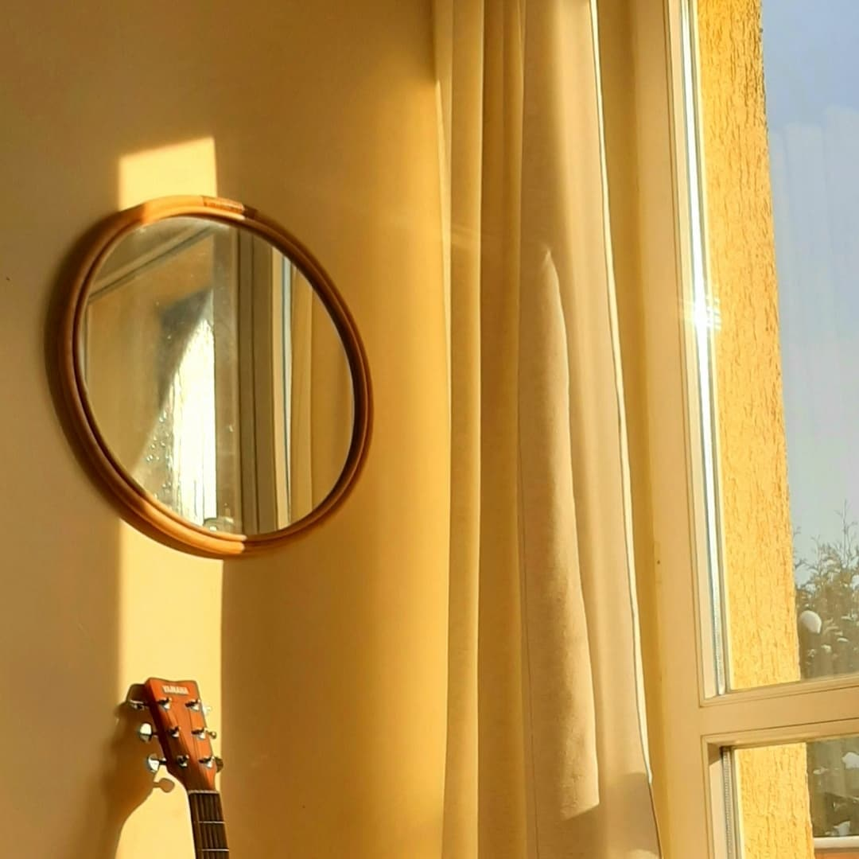
Weeks end with weekends
There are no weekendends, so
when do weekends end?

Slide 13
